Slide 1
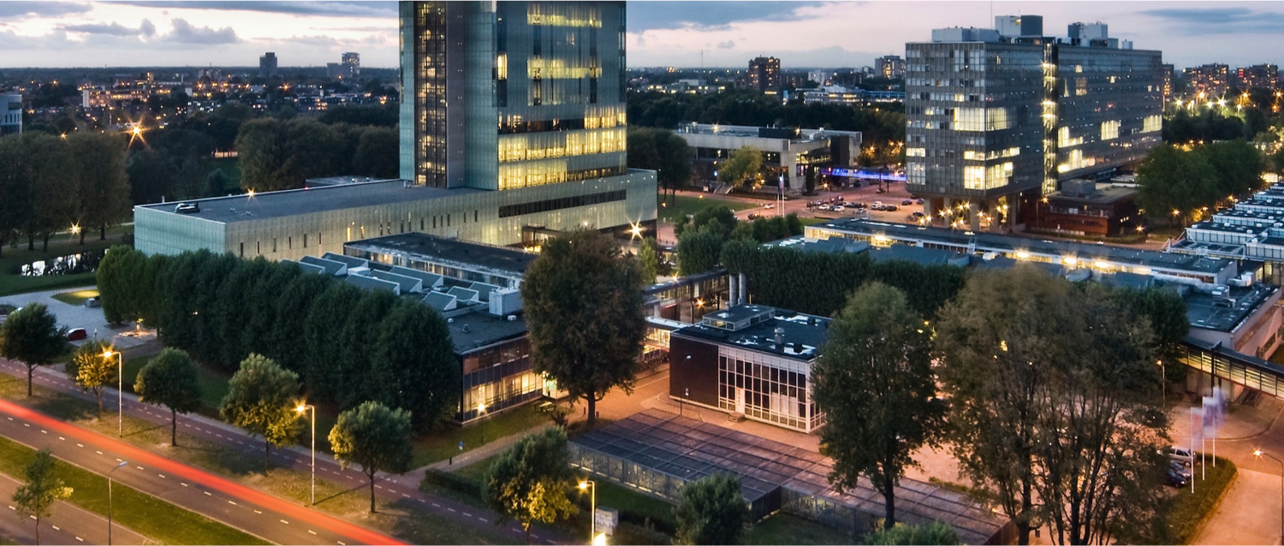
Supervisor meeting, Thursday May 20th

Slide 2
Progress
What was discussed in the previous meeting:
What we did so far since previous meeting:

Slide 3
Progress
Results?

Slide 4
Second version overview (Not complete yet)
batch_id/LLM_output/*.net
validation_results.json
Using a model provided by snellius (Qwen-3-14B) to generate topologies and train.
Validation algorithm goes over each topology using a checklist
Valid topologies are considered for simulation, necessary metrics are extracted from the simulation results.
simulation_results.csv
Update weights
reward_results.json
GRPO loop, processes the scores and updates the weights.
Extracted metrics are used to measure fitness score in reward function

Slide 5
Next steps

